Slide 1


Drone Based Mapping and Ground Based Robotic Precision Spray System for Field Crops

Slide 2
Team Roles (Sprint 4)
Logan Sutton
Frontend & Backend structure and integrations
Path generation and storage
UI functionality
Gil Rezin
Creating field maps from orthophotos
Clustering NDVI values for grid overlay
Identify unique clusters from cell values

Slide 3
Sprint 4 Objectives/Goals
Path finding (given shapefile)
Find a suitable path finding algorithm and implement it
Update user interface to support path previews
Integrate pathing into project pipeline
Refactor prescription generation
Simplify approach to support Raven RTK vertex constraint
Produce shapefile output file with prescription details
Allow user to specify categories of spray detail

Slide 4
Sprint 4 Objectives/Goals & Overall vision
Path finding module
Robot must autonomously traverse field
We can’t spray the field if we can’t traverse it
Prescription module
Robot must be able to autonomously spray the field
While the robot is traversing it’s path, we read the prescription map
Spray based on where we are on the path

Slide 5
Feature Implementation (Logan)
Pathing algorithm using Fields2Cover (Python)
Generations a snake-pattern path based on a shapefile boundary
Can specify path width and headlands
Supports obstacles in field
Must be defined by the field boundary
Generated path converted to Farmng amiga waypoints
Waypoints stored in json format for Amiga
Displayable on the UI
UI has pathing visualization
Specify robot width, swath width, preview path on map

Slide 6
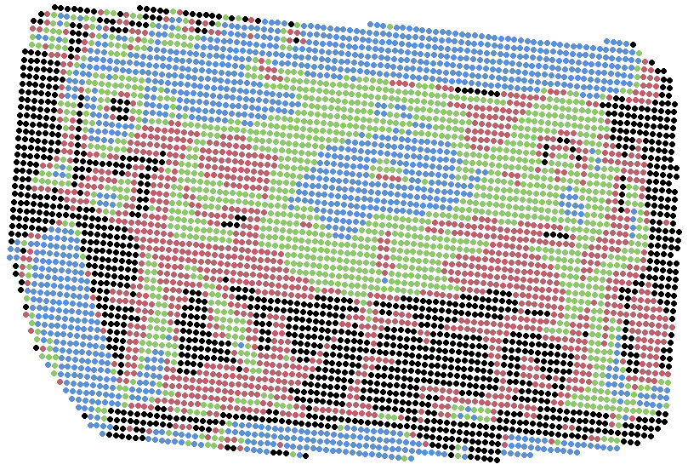
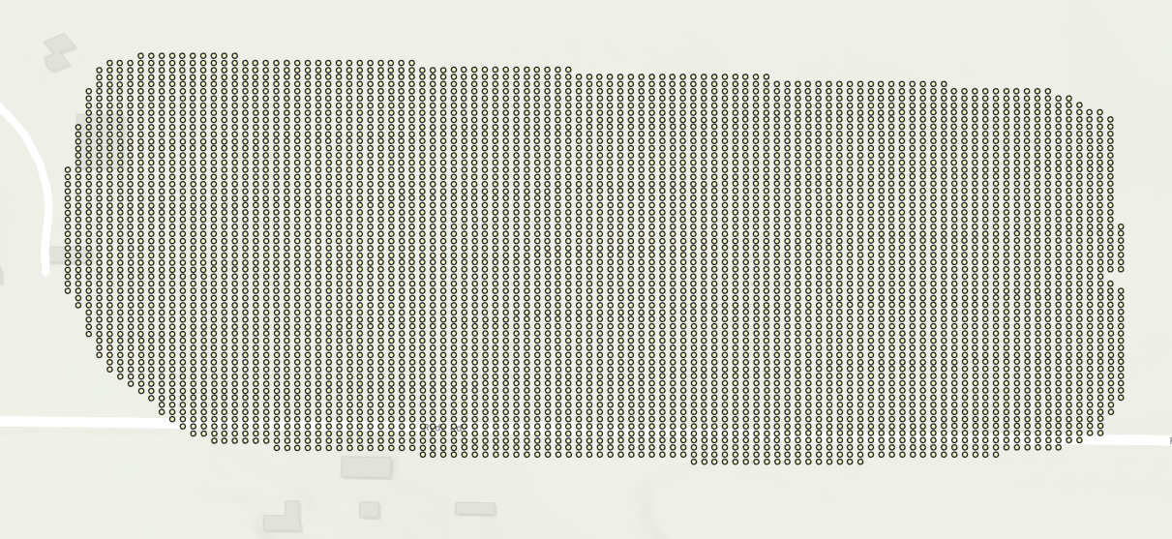
Feature Implementation (Gil)
Clustering algorithm re-implemented with bucketing
Assign quantile buckets based on relation to plant health
Plant health threshold & bucket count defined by farmer
Data smoothened with Gaussian blur for simplified cluster output
Field resolution auto-defined by farmer hardware limitations
Data output into shapefile
File format for easy geometric visualization
Ready for integration with pathfinding

Slide 7
Demo

Slide 8
Planned Testing
Path testing with robot in parking lot
Test pathing module by letting the robot traverse an empty parking lot
Prescription testing
Additional field data provided by Andrew
Recently sprayed field
Larger, non-rectangular fields
Unit testing
Unit tests for each module, some already started/implemented
End-to-end testing expected when pipeline is completely integrated

Slide 9
Kanban Board

Slide 10
Proof of MoM

Slide 11
Overview of Report Changes
Separate pathing module from prescription module pipeline dependency
Add info about field2cover and pathing module
Talk about future tests
Unit
Integration
Functional
Refactor info on prescription module
Adjust requirements
Vertex maximum for prescription polygons

Slide 12
Gen AI usage
Frontend creation and modifications
Entirety of frontend has been built this way, per client request
Utilized Cursor IDE
Backend refactoring
Brainstorm ideas on how to reimplement
“Rewrite this code to output y instead of x”
Writing unit tests
Provide a specific section of code to unit test
Does decently well, can’t give to big of task
Assistance with debugging errors
Code cleanup

Slide 13
Improvement from Sprint 3
Path finding is done and integrated
Proved to be a difficult task for Sprint 2 and Sprint 3
Completed with Fields2Cover library
Integrated with frontend
Just needs testing (looks like it works initially)
Prescription module is done
Initial setup from prior sprints required complete rethink
Used built-in statistics analysis within R
Requires integration with pathfinding
Works very well on test field, requires comprehensive testing now

Slide 14
Achievements and Challenges
Achievements
Path finding complete
Huge milestone, one of biggest tasks in previous sprints
Prescription module done
Another big milestone
Just needs integration and some testing
Challenges
Conversion of prescription points to polygons
Necessary for robot spraying
Still have frontend file streaming issues
To be completed in early sprint 5
Entire pipeline was not completed
Expected mid sprint 5
Testing path upload and planning has proven difficult
Engineering team is struggling with Amiga robot hardware

Slide 15
Next steps
Complete entire pipeline integration by mid sprint 5
Test each module with unit and integration tests
Test pathing module with full test in parking lot
Test UI with Jest
Ensure we can upload files to Amiga
Engineering team resolves hardware issues

Slide 16
Thank you!
We’re excited to continue developing this system in Sprint 5!

